Slide 1
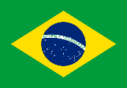
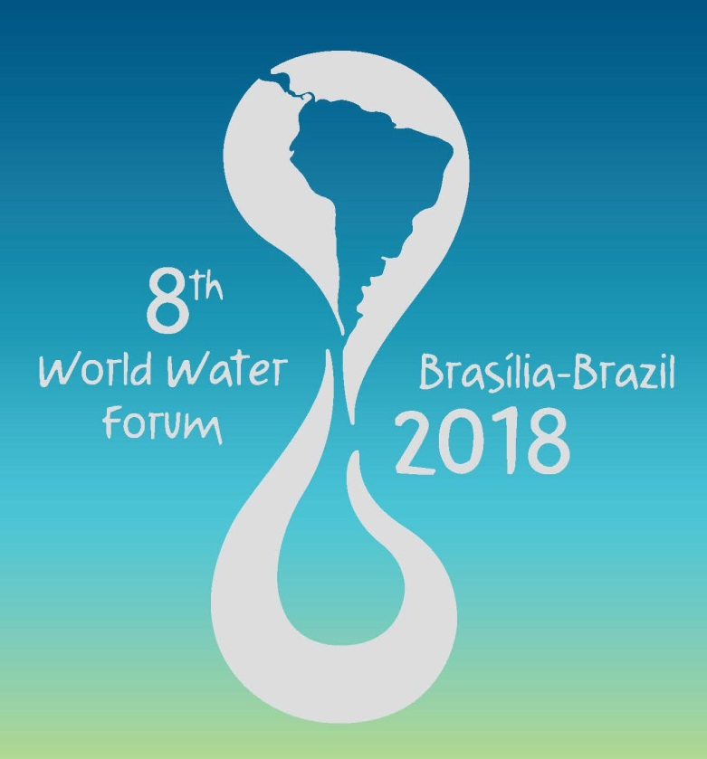

Slide 2
Principais Objetivos
Promover a consciência coletiva global sobre água;
Construir compromissos políticos;
Promover ações concretas sobre assuntos relacionados à água em todos os níveis;
Promover a conservação, a proteção, o desenvolvimento, o planejamento, a gestão e o uso eficiente da água em todas as suas dimensões, de maneira sustentável.
Notes:
O Fórum, desde sua primeira edição em 1997, tem ganhado em importância. Os números mostram isso de forma clara.

Slide 3
THE WORLD WATER FORUM
City | Year | N° of participants | High level representatives
Marrakesh, Morroco | 1997 | 500 | -
Haia, Netherlands | 2000 | 39.000 | 114 officials from 13 countries
Kyoto Japan | 2003 | 25.000 | Officials from 142 countries
Mexico City | 2006 | 27.500 | 270 officials from 140 countries
Istambul, Turkey | 2009 | 30.000 | 250 officials from 182 countries and 1ª Heads of State meeting
Marseille, France | 2012 | 35.000 | 15 Heads of State, 112 officials from 173 countries
Daegu / Gyeongbuk, South Korea | 2015 | 40.000 | 10 Heads of State, 121 officials from 168 countries
Notes:
O Fórum, desde sua primeira edição em 1997, tem ganhado em importância. Os números mostram isso de forma clara.

Slide 4
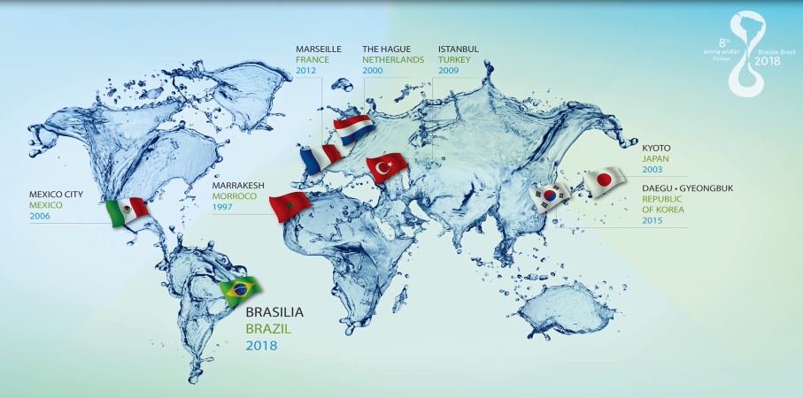
World Water Forum
Notes:
O Fórum Mundial da água tem o objetivo de promover a consciência coletiva global sobre água, construir compromissos políticos e promover ações concretas sobre assuntos relacionados à água em todos os níveis. A primeira edição do Fórum ocorreu em Marrocos em 1997, depois na Holanda em 2000, no Japão em 2003, no México em 2006, na Turquia em 2009, na França em 2012 e na Coréia do Sul em 2015. O Brasil irá sediar a oitava edição em 2018, que será a primeira vez no continente e a primeira vez no hemisfério sul. Daí a enorme responsabilidade do Brasil também por representar todo o continente sul americano.

Slide 5
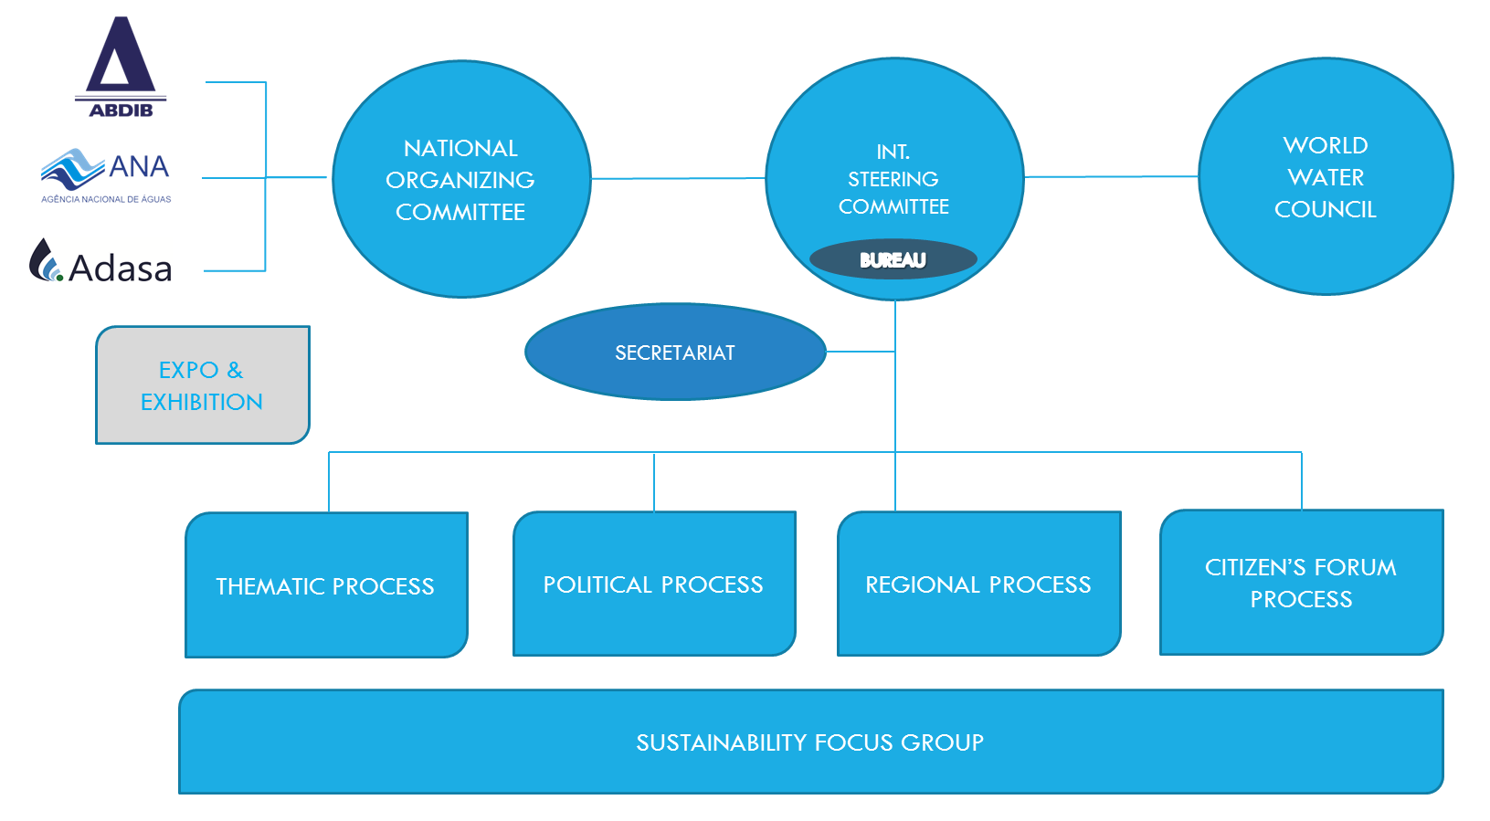
8th World Water Forum Governance

Slide 6
Thematic Commission
Brief Status of the Thematic Process
Jorge Werneck Lima
Vice-Chair of Thematic Commission
on behalf of the TC
CRH-DF,
20 September 2017,
Brasília, DF

Slide 7
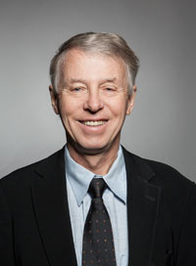
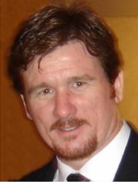
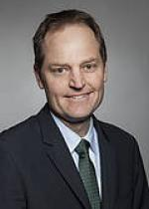
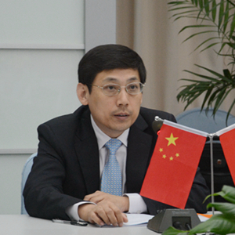
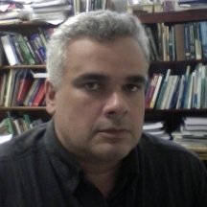
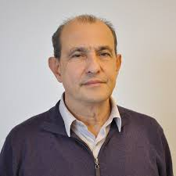
THEMATIC COMMISSION
Torkil Jønch Clausen
DHI Group (Chair)
Jorge Werneck Lima
EMBRAPA (Vice-Chair)
Mark Smith
IUCN
Ana Paula Fioreze
ANA
Laila Oualkacha
Ministry of Water
Resources of Morocco
Dirceu Reis
UnB
Alceu Bitencourt
ABES
Zhiguang Liu
Ministry of Water
Resources of China

Slide 8
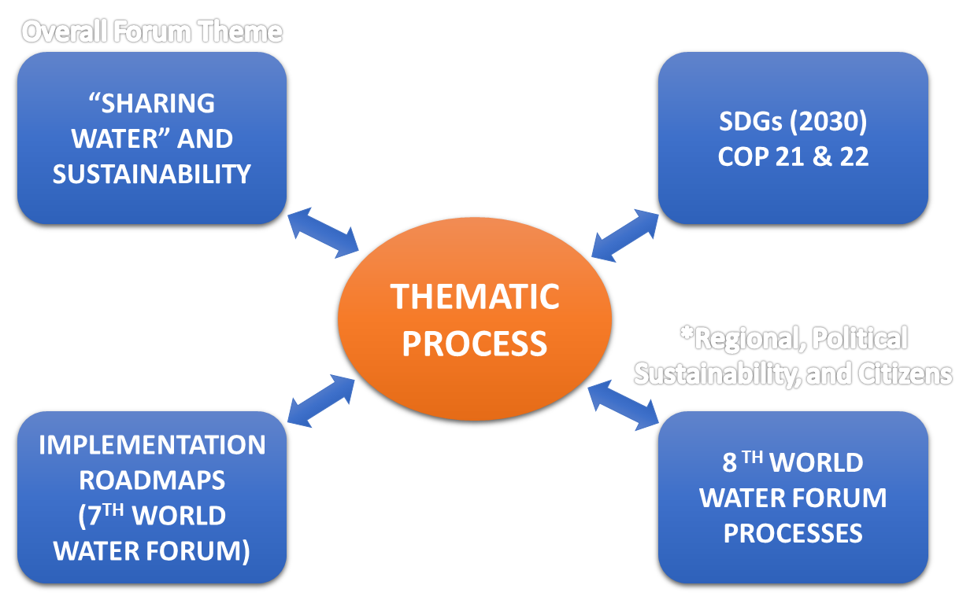
THEMATIC PROCESS: 4 important linkages

Slide 9
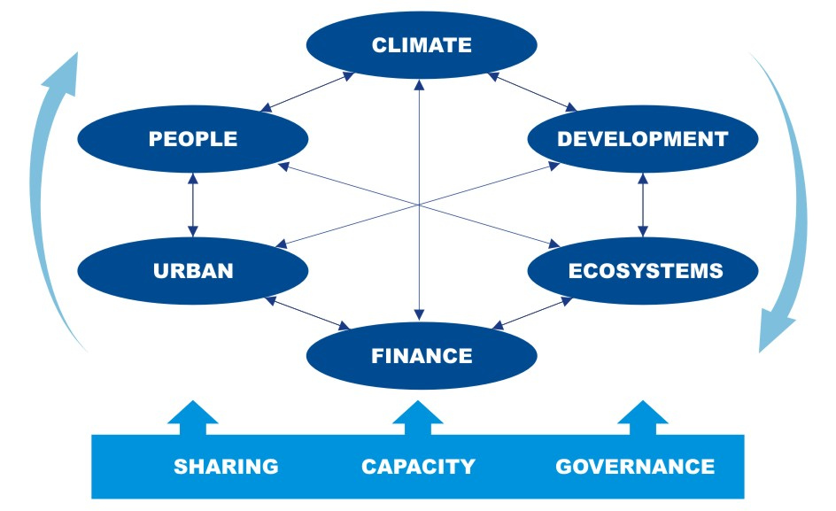
THEMATIC STRUCTURE

Slide 10
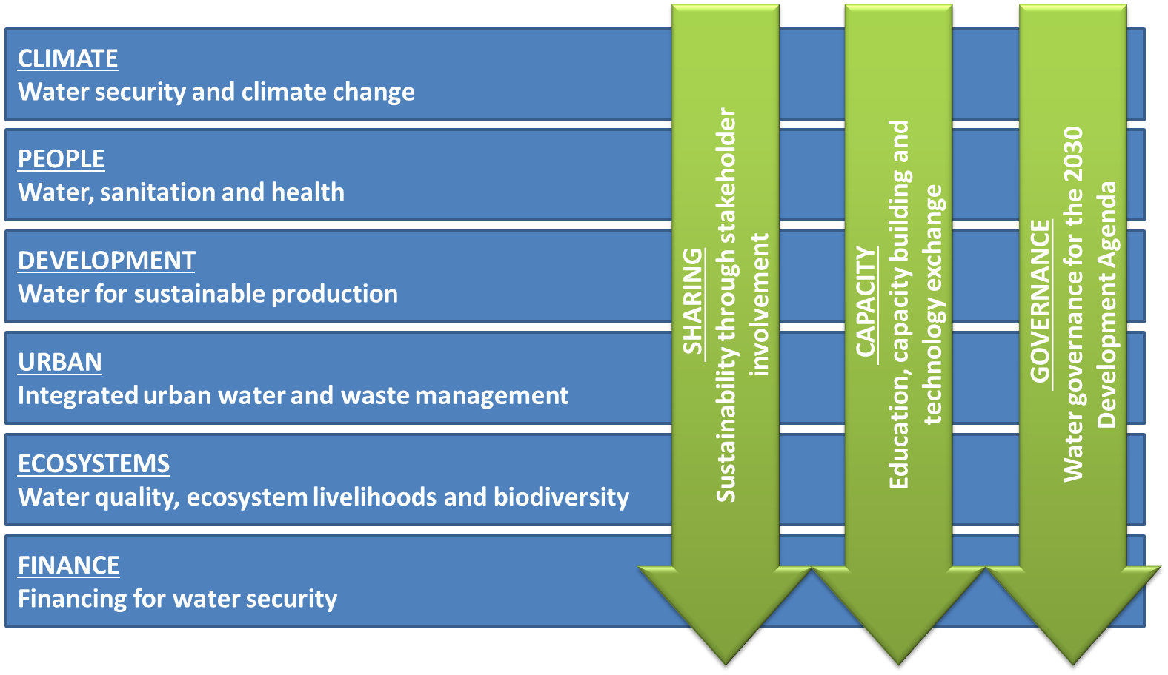
THEMATIC FRAMEWORK
6 themes and 3 cross-cutting issues

Slide 11
Thematic Process
THEMES AND TOPICS
CLIMATE – Water security and climate change
(SDG links: SDG 13, SDG 11.5, COP 21-22, Sendai DRR Summit)
Managing risk and uncertainty for resilience and disaster preparedness – IR 1.3
Water and adaptation to climate change
Water and climate change mitigation
Climate science and water management: the communication between science and decision/policy making
PEOPLE - Water, sanitation and health
(SDG links: Water targets 6.1, 6.2, 6.3, 6.B and SDG’s 1 and 3)
Enough safe water for all – IR 1.1
Integrated sanitation for all – IR 1.2
Water and public health

Slide 12
Thematic Process
THEMES AND TOPICS
DEVELOPMENT - Water for sustainable development
(SDG links: Water target 6.4 and SDG’s 2, 7, 8, 11 and 12)
a. Water for Food - IR 2.1
b. Water for Energy - IR 2.2
c. Inclusive and sustainable growth, water stewardship and industry – IR 3.1
d. Efficient use of surface water and groundwater - urban and rural
e. Infrastructure for sustainable water resource management and services – IR 1.4
URBAN - Integrated urban water and waste management
(SDG links: Water target 6.3 and SDG 11 and 14, HABITAT 3)
Water and cities – IR 2.3
The circular economy – reduce, reuse, recycle
c. Treatment and reuse technologies

Slide 13
Thematic Process
THEMES AND TOPICS
ECOSYSTEMS - Water quality, ecosystem livelihoods and biodiversity
(SDG links: Water target 6.3, 6.6 and SDG 15)
Managing and restoring ecosystems for water services and biodiversity – IR 3.2
Natural and engineered hydrological systems
Water and land use
Ensuring water quality from ridge to reef – IR 3.3
FINANCE - Financing for water security
(SDG link: SDG’s 6 and 17)
Economics and financing for innovative investments – IR 4.1
Financing implementation of water-related SDGs and adaptation to climate change
Finance for sustainable development – supporting water-friendly business

Slide 14
Thematic Process
Cross-Cutting Issues and Topics
SHARING – Sustainability through stakeholder involvement
(SDG link: Water target 6.b and SDG’s 3, 15 and 17)
Sharing solutions and good practices
Involving all : public, private, civil society – women and men – young and old - in bottom up and top down approaches
Water cultural diversity, justice and equity – IR 4.4
CAPACITY - Education, capacity building and technology exchange
(SDG link: Water target 6.a and SDG’s 4 and 17)
Enhancing education and capacity building – IR 4.5
b. Science and technology – 7th WORLD WATER FORUM S&T Process
c. ICT and monitoring
d. International cooperation

Slide 15
Thematic Process
Cross-Cutting Issues and Topics
GOVERNANCE – Water governance for the 2030 development agenda
(SDG link: Water target 6.5, SDG 17)
a. SMART implementation of IWRM – IR 3.4
Cooperation for reducing conflict and improving transboundary water management – IR 4.3
Effective governance: Enhanced political decisions, stakeholders participation and technical information – IR 4.2

Slide 16
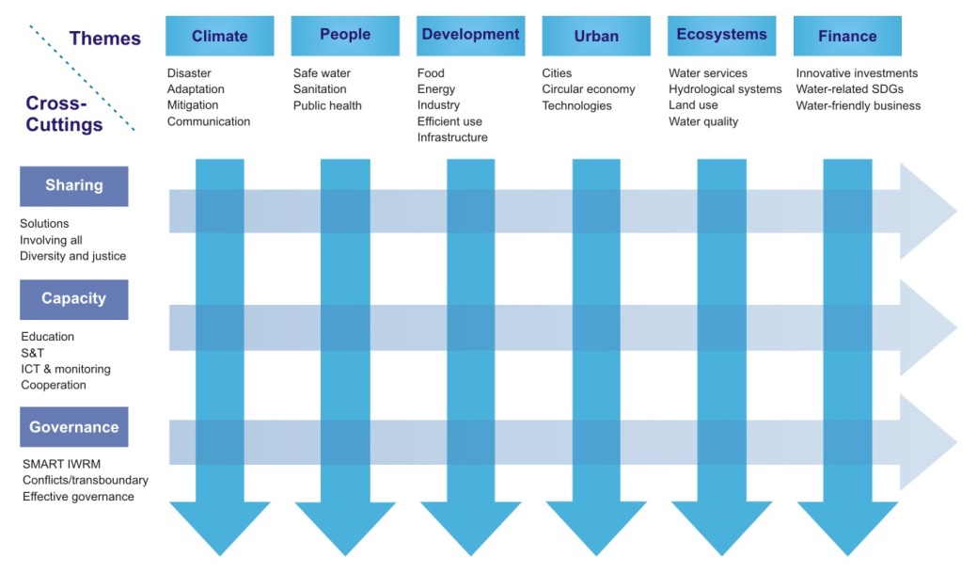
THEMATIC FRAMEWORK
6 themes + 3 cross-cutting issues + 32 topics

Slide 17
THEMATIC FRAMEWORK
Themes - CCIs Linkages
3 Questions
4 Questions
3 Questions

Slide 18
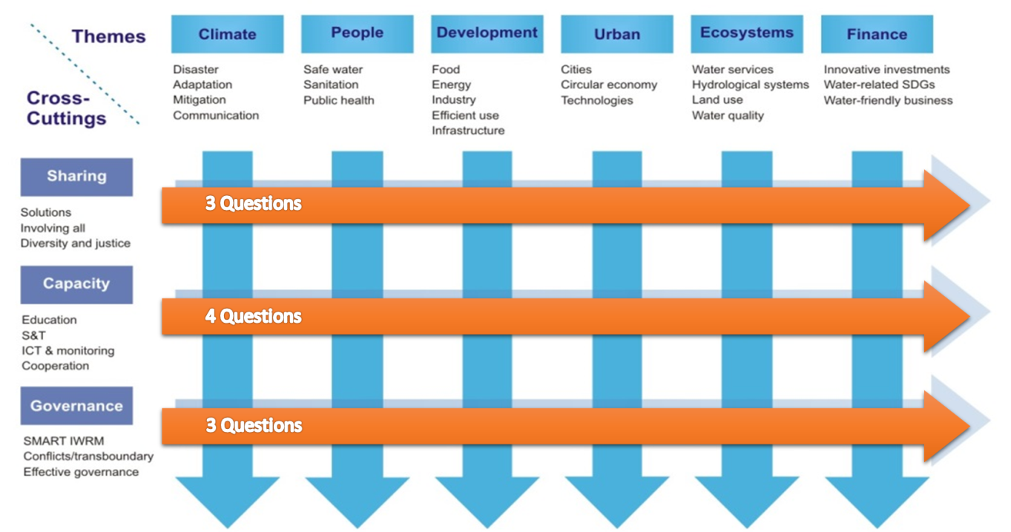
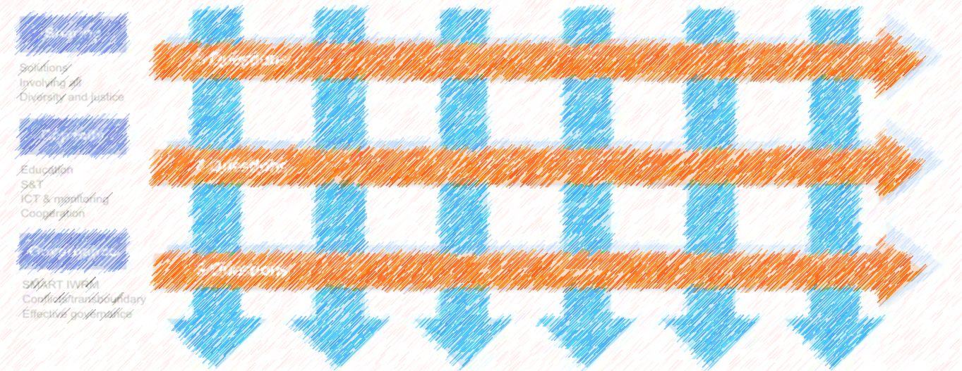
THEMATIC FRAMEWORK
Linkages with other processes
Regional Process
Regional focal points for each theme
TCGs
inter-regional thematic sessions
Key questions/issues from the Sustainability Focus Group
Key questions/issues from the Citizens Process
Optimize synergies among sessions
List of institutions to be considered
to be shared with and addressed by all themes

Slide 19
THEMATIC FRAMEWORK
Institutions/People involved
9 THEMES
~45 TCGs
145 ≠ orgs.
32 TOPICS
~148 ToCGs
96 SESSIONS
+ Special Sessions and High-Level Panels
~400 SCGs
Led by Thematic, Topic and Session Coordination Groups
- each group 4-5 international/regional/national organisations -
Ongoing process

Slide 20
THEMATIC FRAMEWORK
Selected TCGs and ToCGs
Full list available at:
http://www.worldwaterforum8.org/thematic-process-commission

Slide 21
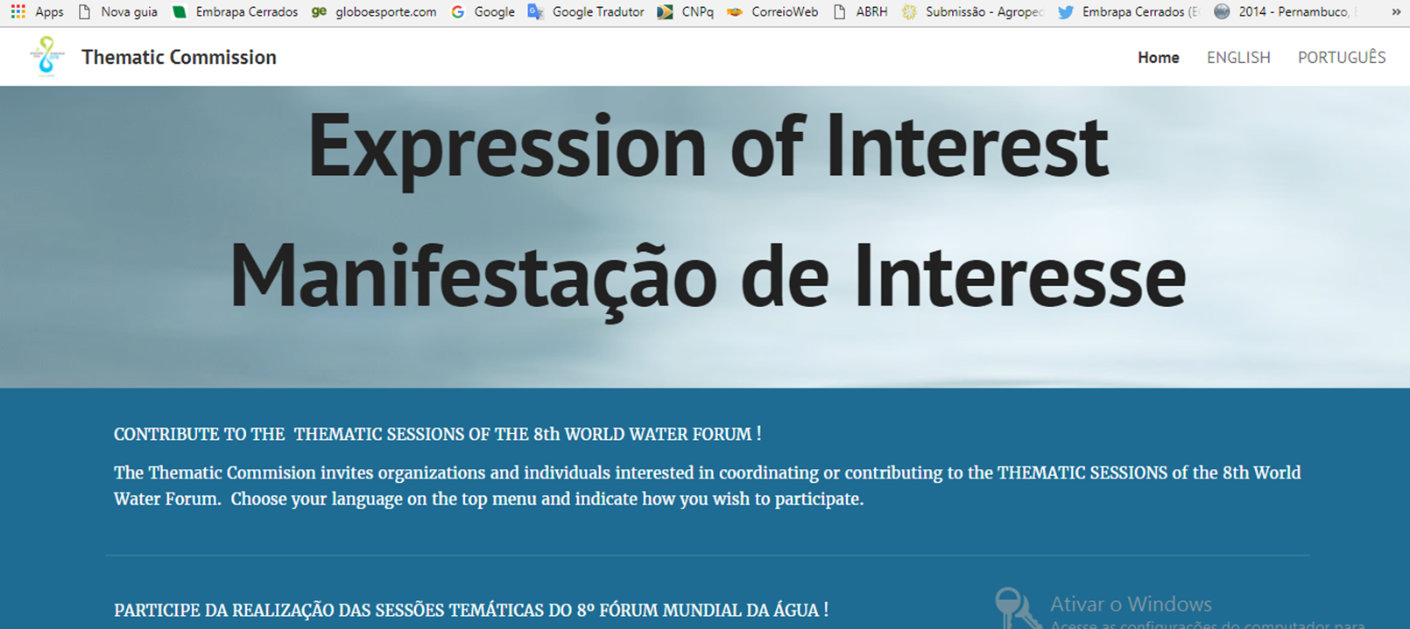
THEMATIC FRAMEWORK
Selected TCGs and ToCGs
http://www.worldwaterforum8.org/thematic-process-commission

Slide 22
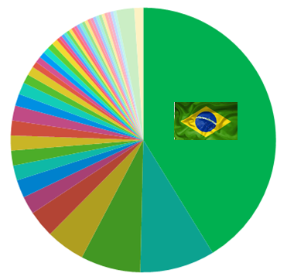
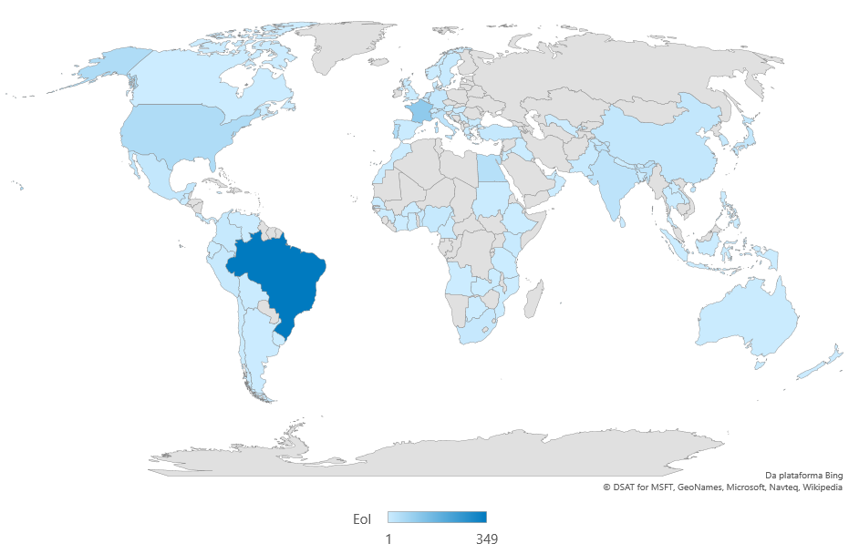
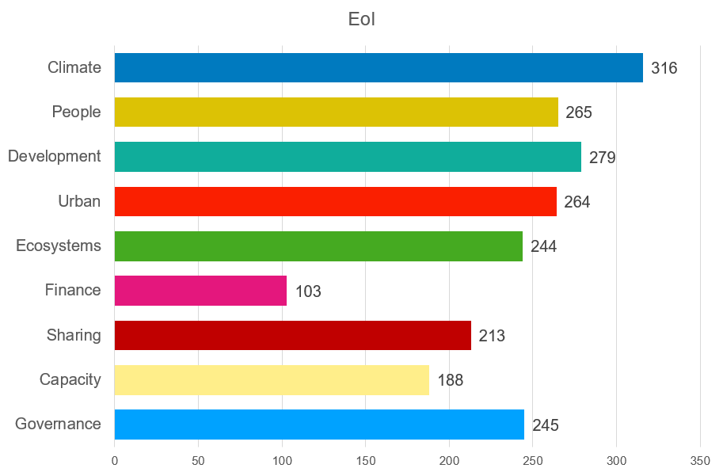
THEMATIC PROCESS
Open call – participate in Thematic Sessions
~35%
± 1,000 forms; from ±80 countries + international organizations
>2,100 applications to participate - Thematic Sessions

Slide 23
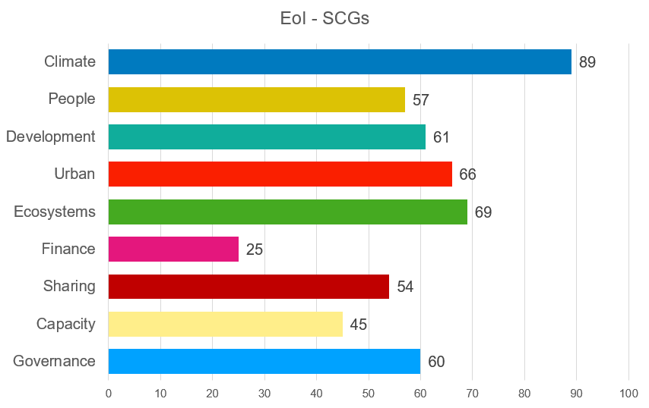
THEMATIC PROCESS
Open call – participate in Thematic Sessions
For SCGs:
± 525 applications

Slide 24
THEMATIC PROCESS
Special Sessions and High-Level Panels
Clear guideline developed and shared:
High-Level Panels
Addressing current global-political key issues
Linking to 2030 Agenda (SDG’s, Paris, Habitat-3, Sendai etc.) and HLPW
High-Level: Ministers, CEO’s, mayors…
Special Sessions
Addressing emerging issues
Balanced, multi-stakeholder participation
Already receiving proposals

Slide 25
Towards 8th Forum outcomes
Starting ISC discussion on 8th Forum outcomes
As presented to ISC in Cancun and in Stockholm (Jun & Sep, 2017)
8th Forum outcomes
The legacy from “Sharing” in Brasilia 2018
Linking forward to World Water Forums 2021 – 2024 -> 2030 Development Agenda
Building on past World Water Forums
Combining outcomes from Political-Thematic-Regional-Sustainability-Citizen
Thematic Commission ’start-ball-rolling’ principles
Few and strong political messages for high-level decision-makers
Combine messages with ‘alliances for action’
Build on 8th Forum thematic framework, focus on SDG/A-2030 implementation
Think long-term, propose short-term milestones and actions

Slide 26
Towards 8th Forum outcomes
Initiating an 8th Forum outcome definition process
As proposed to ISC in Cancun and in Stockholm (Jun & Sep, 2017)
Some specific initial thematic messages to consider:
Focus on accelerating implementation of water-related SDG (and other A-2030) targets through country level multi-stakeholder action that is gender/age balanced
Propose action goals for themes/topics for 2021-2024, continuing tracking of actions from previous WWF’s
Prioritize actions driving acceleration and up-scaling of implementation
Promote/encourage formation of ‘alliances for action’, building i.a. on more than 300 Thematic Coordination Organisations at theme-topic-session levels, the 16 Implementation Roadmaps, and new water/non-water actors
Integrate with messages from other Forum processes

Slide 27
THEMATIC PROCESS
Way forward – immediate milestones
Thematic Sessions:
End-September: Selection of Session Coordinators
October: Detailed session development starting
Linkage to other processes:
September: Agreement on Thematic-Regional coordination mechanisms
September: Agreement on coordination with all processes
High-Level Panels/Special Sessions:
November: Selection of SS/HLP

Slide 28
THEMATIC PROCESS
Way forward – immediate milestones
Forum outcomes:
September: ISC discussion and decision
Forum session planning:
September: Clarity on thematic linkage with other Forum processes
October: Start joint session planning, primarily Thematic-Regional
November: Start overall Forum session planning

Slide 29
Thematic Commission
Brief Status of the Thematic Process
Jorge Werneck Lima
Vice-Chair of Thematic Commission
on behalf of the TC
Thank you for your attention !!!
CRH-DF,
20 September 2017,
Brasília, DF

